Slide 1



From patients to publications!
Lisa Roberts PhD MCSP
Arthritis Research UK senior lecturer in physiotherapy / consultant physiotherapist
University Hospital Southampton
NHS Foundation Trust

Slide 2

‘What will you add to the evidence base of your profession?’
Clinical audit
Service evaluation
Research
Higher degree MSc, MRes, MPhil, Clinical doctorate, PhD
Publication
Conference presentation

Slide 3
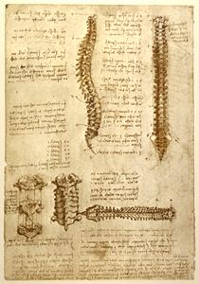

Leonardo da Vinci: anatomist
… publish!

Slide 4
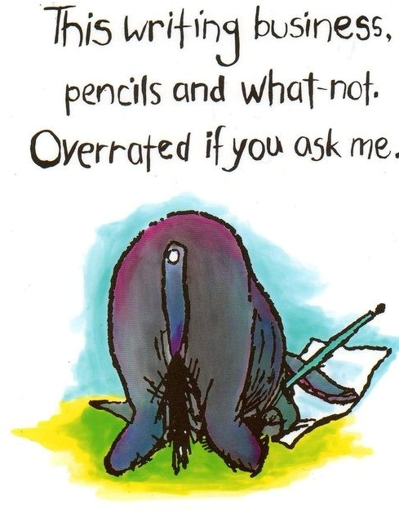

www.caricatures-ireland.com/blog

Slide 5

Quick wins with publications
Recent MSc thesis or assignment
Interesting case study
Clinical data eg. a case series
Review
Audit or service evaluation
Letter responding to an article ….

Slide 6

Advantages
Hugely rewarding – enrichment & diversity
Develops evidence base for profession
Strengthens your position & your department during current economical climate
Helps defend / justify AfC banding
Good for promotion
Opens doors eg. clinical academic career in future

